Slide 1


StNet: Local and Global Spatial-Temporal Modeling for Action Recognition
$$Dongliang He^{∗} Zhichao Zhou^{∗} Chuang Gan^{\$} Fu Li^{∗}$$
$$Xiao Liu^{∗} Yandong Li^{\&} Limin Wang^{\#} Shilei Wen^{∗}$$
$\#$ Nanjing University, China
$\&$ University of Central Florida, USA
$\$$ Massachusetts Institute of Technology, USA
$∗$ Department of Computer Vision Technology (VIS), Baidu Inc.

Slide 2
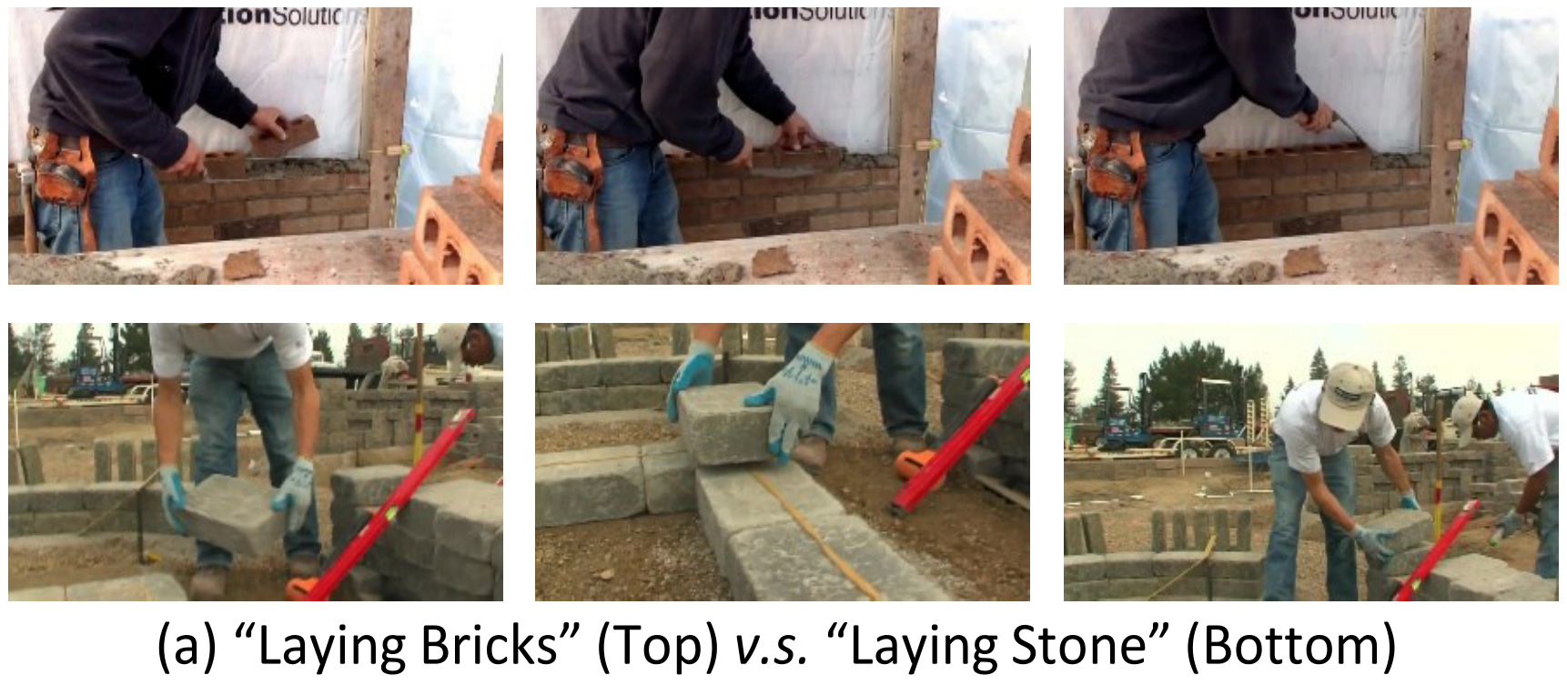
Action Recognition – A Case Study
Spatial information (S) is an important clue

Slide 3
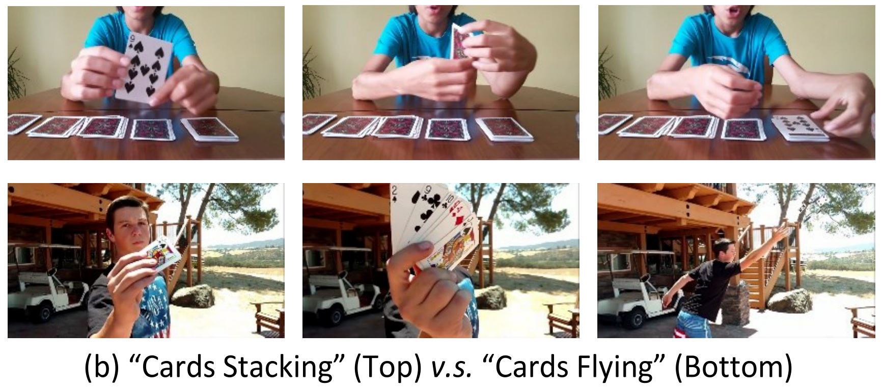
Action Recognition – A Case Study
Spatial information (S) is one of important clues
Temporal (T) relation is the other key

Slide 4
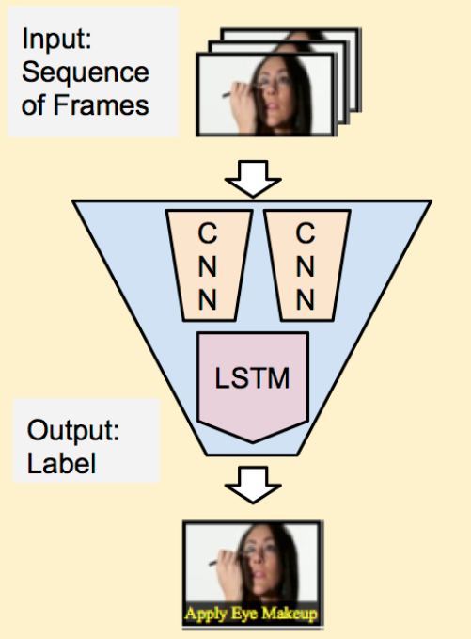
Action Recognition – Existing SOTAs
CNN + RNN
CNN for S modeling
LSTM for T modeling
Separately spatial-temporal modeling
Harder to be end-to-end trained

Slide 5
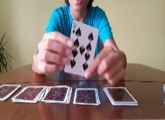
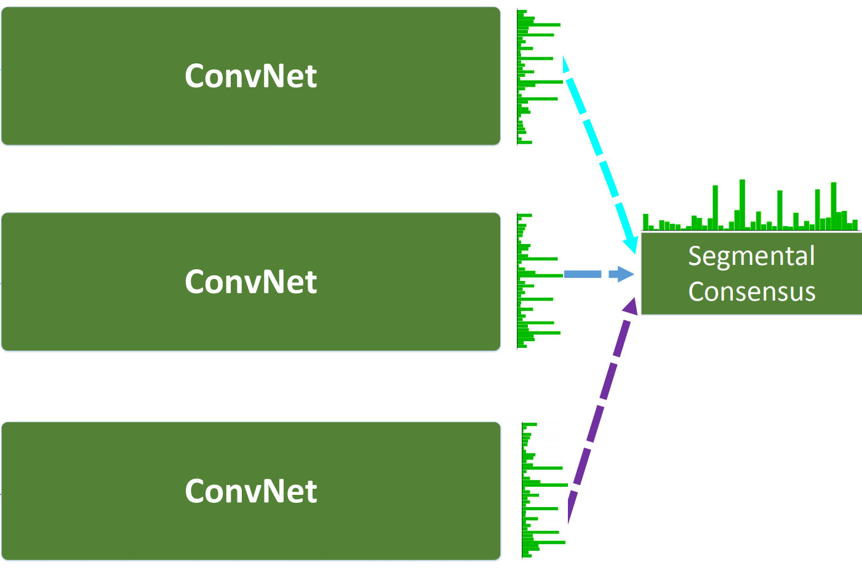
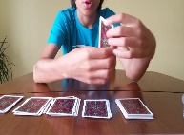

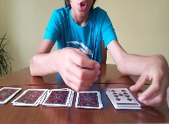
Action Recognition – Existing SOTAs
2D-Conv Solutions
TSN/TRN/…
Local S-T relation ignored
Global T-relation unexploited
3D-Conv Solutions
C3D/I3D/ARTNet/…
Joint S-T modeling
Huge #params / #FLOPs
3D ConvNet

Slide 6
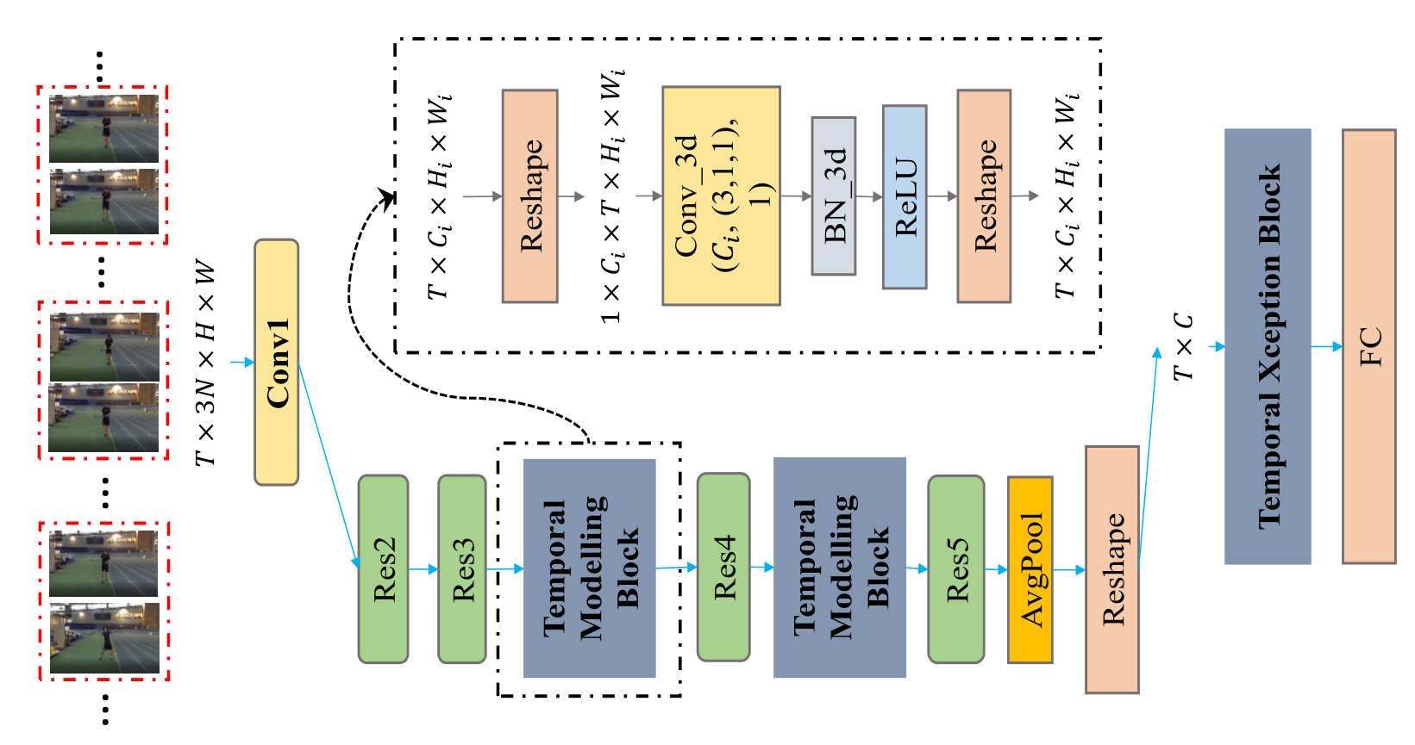
StNet – Joint Local and Global S-T modeling
Overall Framework – Taking ResNet as exemplar backbone
1
N
2
T
Temporally sampling “super-images”
2D-Conv on super-images for local S-T modeling
Stacked 3D/2D-Conv blocks for global S-T modeling
Temporal 1D-Xception for long term dynamic modeling

Slide 7
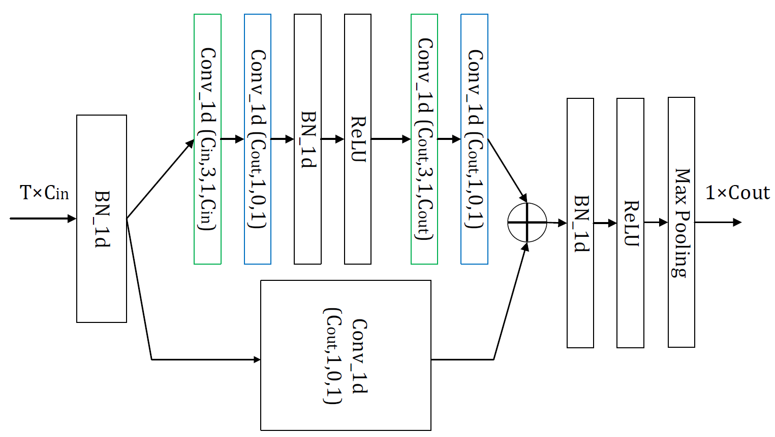
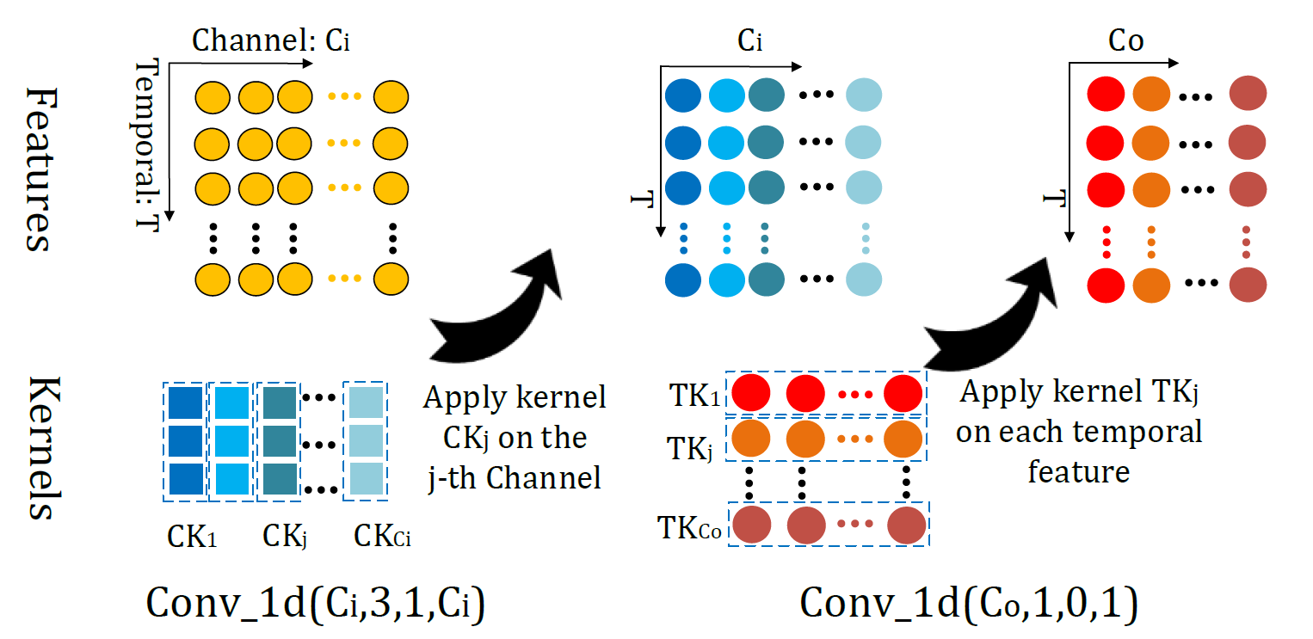
StNet -- Temporal Xception Block
Separate channel-wise and temporal-wise 1D Conv
Conv-based sequence modeling, easy for end-to-end training
#Kernel
Kernel_size
Padding
#Groups

Slide 8
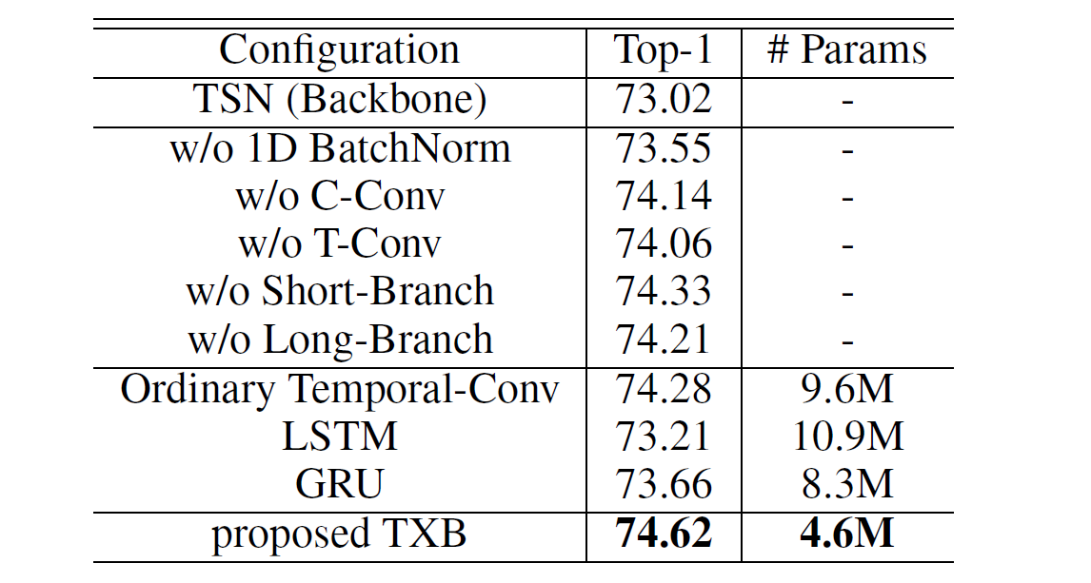
StNet – Ablation Studies
Temporal Xception Block for sequence modeling
Exp. on Kinetics-400 with InceptionResnet-V2 as backbone

Slide 9
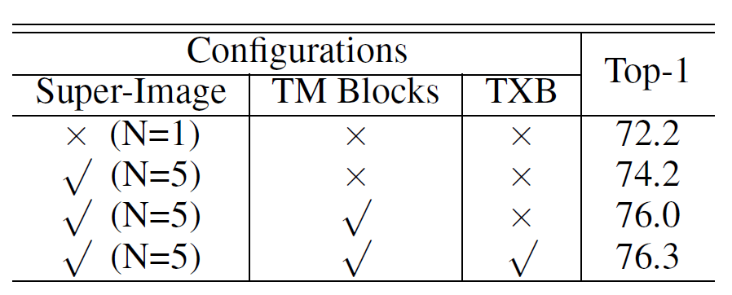
StNet – Ablation Studies
Contribution of each component
Exp. on Kinetics-600 with backbone of InceptionResnet-v2, T=7

Slide 10
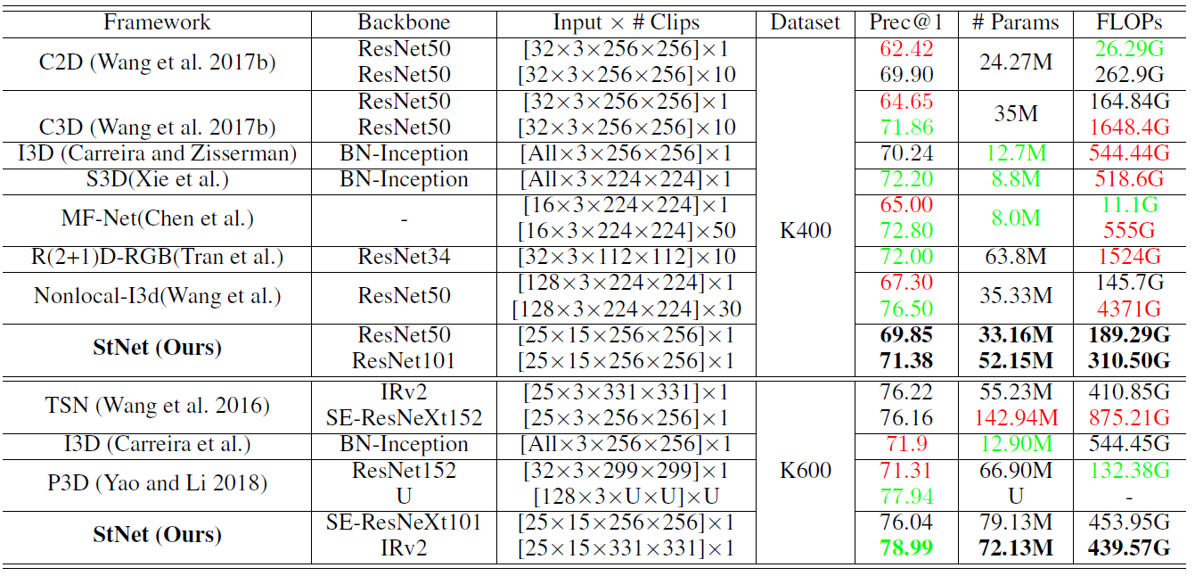
StNet – Comparison with SOTAs
Exp. on Kinetics400
Comparable #FLOPs, better Prec@1
Comparable Prec@1, less #FLOPs

Slide 11
StNet – Comparison with SOTAs
Exp. on Kinetics600
Same backbone, better performance
Same performance, shallower backbone

Slide 12
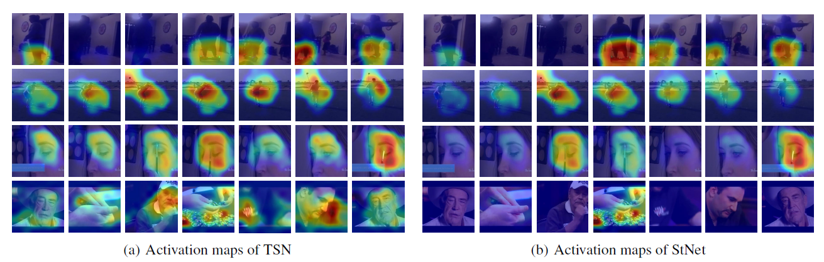
StNet – Visualization
From top to bottom: “hoverboarding”, “golf driving”, “filling eyebrows” and “playing poker”

Slide 13
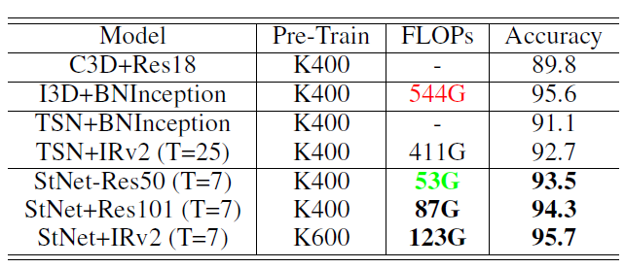
StNet – Transfer Learning
Exp. on UCF101

Slide 14
Conclusion
Spatial-Temporal modeling is essential for action recognition
Both local and global spatial-temporal relation are modeled in StNet
StNet significantly outperforms SOTAs in terms of Accuracy-FLOPs trade-off
StNet achieves state-of-the-art performance on Kinetics600
StNet shows great transfer learning capability.

Slide 15
Q&A

